Slide 1

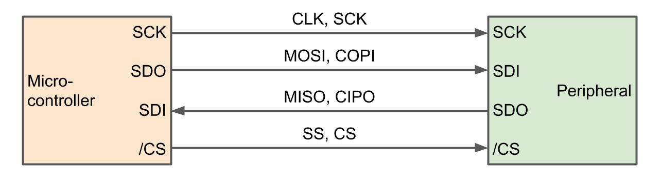
Design and Verification of Single Master Single Slave SPI
This project aims to ensure reliable communication by verifying and designing a Single Master Single Slave SPI Protocol using Verilog and System Verilog.
Mentor: Ms. Neha Sharma

Slide 2







Team Members :
Parnika Sisodia
Poulami Paul
Pragya Gupta
Prerna Mittal
Pujithapydi
Sakshi Jawanjal

Slide 3
Content
Introduction
Verilog code overview
System verilog code overview
conclusion or results

Slide 4
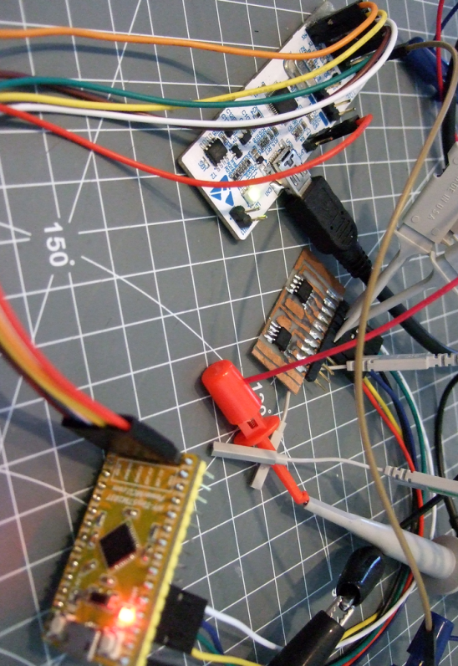
About SPI Communication
SPI is a common communication protocol used by many different devices. For example, SD card modules, RFID card reader modules, and 2.4 GHz wireless transmitter/receivers all use SPI to communicate with microcontrollers.
One unique benefit of SPI is the fact that data can be transferred without interruption. Any number of bits can be sent or received in a continuous stream. With I2C and UART, data is sent in packets, limited to a specific number of bits. Start and stop conditions define the beginning and end of each packet, so the data is interrupted during transmission. Devices communicating via SPI are in a master-slave relationship. The master is the controlling device (usually a microcontroller), while the slave (usually a sensor, display, or memory chip) takes instruction from the master. The simplest configuration of SPI is a single master, single slave system, but one master can control more than one slave.

Slide 5
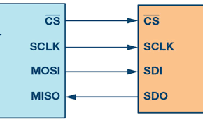
Configuration
MOSI (Master Output/Slave Input) – Line for the master to send data to the slave.
MISO (Master Input/Slave Output) – Line for the slave to send data to the master.
SCLK (Clock) – Line for the clock signal.
Clock polarity can be set by the master to allow for bits to be output and sampled on either the rising or falling edge of the clock cycle.
Clock phase can be set for output and sampling to occur on either the first edge or second edge of the clock cycle, regardless of whether it is rising or falling.
SS/CS (Slave Select/Chip Select) – Line for the master to select which slave to send data to

Slide 6
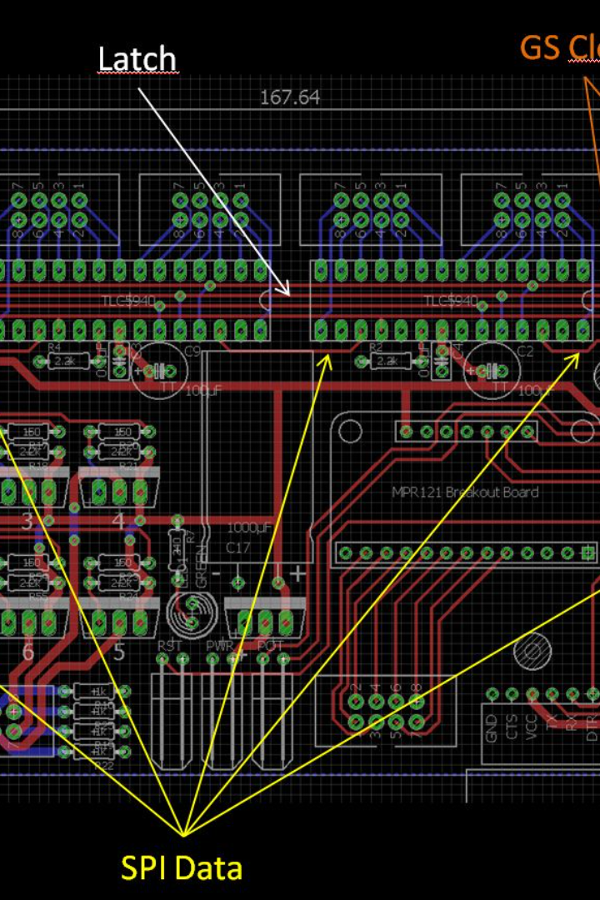
Steps of SPI Data Transmission
The master outputs the clock signal.
2. The master switches the SS/CS pin to a low voltage state, which activates the slave.
3. The master sends the data one bit at a time to the slave along the MOSI line. The slave reads the bits as they are received
4. If a response is needed, the slave returns data one bit at a time to the master along the MISO line. The master reads the bits as they are received.

Slide 7

Verilog Code Overview
The Verilog code for the SPI master and slave modules initializes internal registers and state variables.
The master module updates intermediate values based on state and inputs, while the slave module updates intermediate values based on inputs and clock edges.

Slide 8
module spi_master( clk, rst, miso, mosi, sck, start, data_in, data_out, busy, new_data ): Initialize internal registers and state variables. always @(*) begin Update intermediate values based on state and inputs. Case state: IDLE: Reset clock and bit counters. If start is active, load input data and move to WAIT_HALF state. WAIT_HALF: Increment the clock counter. If half of the clock period has passed, reset the clock and move to TRANSFER state. TRANSFER: Increment the clock counter. On the rising edge, set mosi to the most significant bit. On the falling edge, shift data and include miso bit. On clock counter full, increment the bit counter. If it's the last bit, go back to IDLE, set output data, and indicate new data. always @(posedge clk) begin If reset is active, initialize registers. Transfer intermediate values to state registers. end endmodule

Slide 9
module spi_slave( clk, rst, ss, mosi, miso, sck, din, dout, done ): Initialize internal registers and state variables.
always @(*) begin
Update intermediate values based on inputs and clock edges.
If slave is selected:
Reset bit counter, load data, and assign most significant bit to miso.
If not selected:
Check rising and falling edges of the clock for data transmission.
On the rising edge, shift in mosi and increment the bit counter.
If 8 bits have been processed, update dout and set done flag, then load new data.
On the falling edge, assign the most significant bit to miso.
always @(posedge clk) begin
If reset is active, reset sequential variables.
Transfer intermediate values to state registers.
end
endmodule

Slide 10

System Verilog Code Overview
The System Verilog code consists of several classes, including the transaction class, generator class, driver class, monitor class, scoreboard class, and environment class.
These classes define variables, mailboxes, and tasks for generating and sending transactions, receiving transactions and driving the virtual interface, monitoring signals and creating transactions, and verifying transaction results.

Slide 11
// Transaction Class
class transaction;
Define random input and output data variables. Define mosi, miso, start, and new_data signals. Function to display transaction details. endclass
// Generator Class
class generator;
Define a transaction variable. Define mailboxes for communication with the driver. Define an "ended" event. Define a repeat count variable. Constructor to initialize mailbox. Task for generating and sending transactions. endclass
// Driver Class
class driver;
Define a virtual interface (vif) and mailbox for communication with the generator. Define the number of transactions. Constructor to initialize vif and mailbox. Task to reset the driver. Task to receive transactions and drive the virtual interface. endclass
// Interface Definition
interface intf(input logic clk, reset); Define signals for the interface. endinterface.
// Monitor Class
class monitor; Define a virtual interface (vif) and a mailbox for communication with the scoreboard. Constructor to initialize vif and mailbox. Task to monitor signals and create transactions. endclass

Slide 12
// Scoreboard Class
class scoreboard; Define a mailbox for communication with the monitor. Define the number of transactions. Constructor to initialize the mailbox. Task to verify transaction results. endclass
// Environment Class
class environment; Define instances of the generator, driver, monitor, and scoreboard. Define mailboxes for communication. Define a virtual interface (vif). Constructor to initialize the components. Tasks for pre-test, test, and post-test phases. endclass
// Test
Define the top-level test program. Create an environment instance. Set the repeat count for the generator. Execute the test.
// Top Module
Define the top-level module with clock and reset signals. Create an instance of the test. Define the SPI master and slave modules. Initialize and configure the testbench environment.
// Testbench Module
Define a testbench module. Instantiate SPI master and slave modules. Simulate clock and signal behavior. Generate and send SPI transactions.

Slide 13
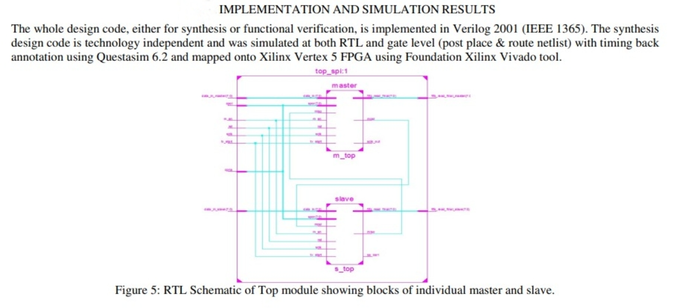
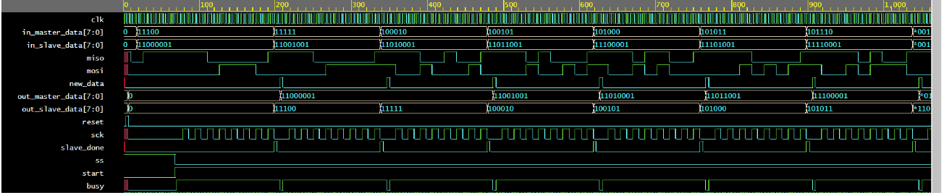
Simulation results :

Slide 14
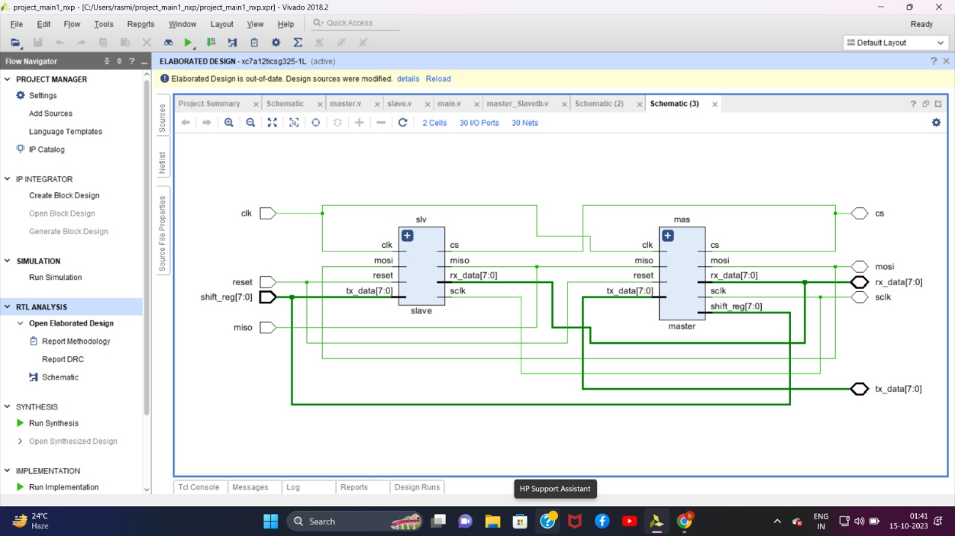

Slide 15




Tech Stack Used
The verilog design and testbench modules and system verilog modules have been compiled and simulated using the Icarus Verilog software.
The waveforms have been generated using GTKWave software .
The netlist, for the modules, has been generated using Xilinx Vivado simulator.
Reference :
Digital Logic and Computer Design Book by M. Morris Mano.
Website :
https://www.chipverify.com/systemverilog/systemverilog-tutorial
https://verificationguide.com/systemverilog/systemverilog-tutorial/

Slide 16
Conclusion
In conclusion, this project successfully verifies and designs a Single Master Single Slave SPI Protocol using Verilog and System Verilog to ensure reliable communication.

Slide 17
THANK YOU!

